Slide 1
Enriching Word Vector
With Subword Information
Piotr Bojanowski, Edouard Grave,
Armand Joulin, Tomas Mikolov
Facebook AI Research
(ACL ‘17)
Kang Cho
goatjo2016@naver.com
Data Intelligence Lab, Koera University
2019.07.25

Slide 2
Problem Statement
How to improve word representations for
morphological rich language?

Slide 3
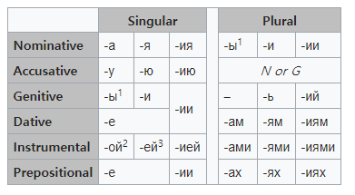
Motivation
What does it meaning to be rich?
A rich language
A language that is not rich
Russian
English
- Subjective
- Objective
- Possessive
Arabic, German, Russian, Czech
English, French, Spanish, Italian

Slide 4
Previous Work
[CHARAGRAM: Embedding Words and Sentences via Character n-grams]
(John Wieting, Mohit Bansal Kevin Gimpel, Karen Livescu. 2016)
Character n-gram count vector
 | wh | he | 〮〮〮
wh | 0 | 4
he | 4 | 0
〮 〮 〮
when a summation is performed over the character n-grams in the sequence,
embeddings are learned so as to produce effective sequence embeddings.
SVD
Notes:
Subword를 생각하게된 계기,, 뭔지 파악할것

Slide 5
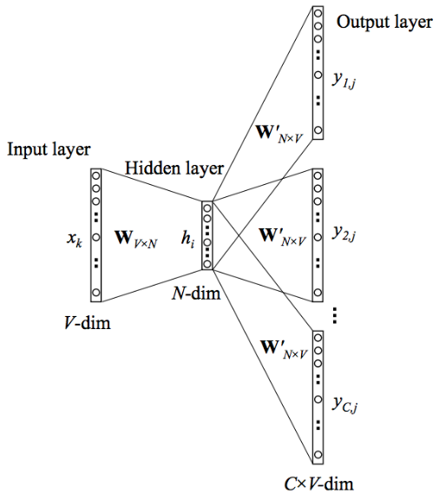
Previous Work
[Word2Vec]
(Distributed Representations of Words and Phrases and their Compositionality,
Tomáš Mikolov, Ilya Sutskever, Kai Chen, Greg S. Corrado, and Jeff Dean. 2013b)
Log-bilinear model
Predict the context word for a given target word
Natural Language Processing is so amazing and funny
Out-of-vocabulary word
Problem
communication
communicative
Notes:
COMMUNICATION / COMMUNICATIVE

Slide 6
Contribution
They suggest an extension of the continuous skip-gram model,
which takes into account subword information.
2. They achieve state-of-the-art performance on word similarity and
analogy tasks.
They trained on the restricted dataset achieves better performance
than the baseline trained on the full dataset.
Notes:
전체적인 문장 다듬을 것, 문법확인

Slide 7
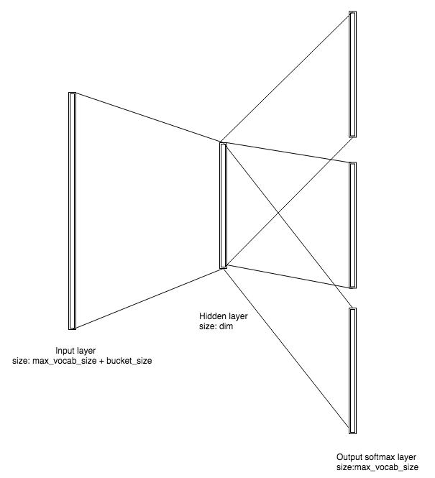



Model
Predicted word
[Subword model]
softmax
[0.02 0.7 0.01 〮〮〮 0.02]
$$W_{t−w}$$
〮
〮
〮
$$W_{t}$$
〮
Input layer
(with subword)
1 hidden layer
1 output layer
〮
〮
$$W_{t+w}$$

Slide 8
Model
N-grams
2-gram : <w, wh, he, er, re, e>
3-gram : <wh, whe, her, ere, re>
4-gram : <whe, wher, here, ere>
5-gram : <wher, where, here>
6-gram : <where, where>
< Input >
A bag of character n-gram
3 ~ 6 n-gram
The sum of the vector representations of its n-grams
Special sequence
<where>

Slide 9
Model
[Subword model]
<wh : [ 0.02 0.03 -0.01 〮〮〮 0.01 ]
whe : : [ 0.01 0.18 0.05 〮〮〮 -0.05 ]
〮
〮
〮
where> : [ 0.01 0.03 0.09 〮〮〮 -0.01 ]
<where> : [ 0.13 0.06 -0.12 〮〮〮 0.03 ]
where
SUM
where : [ 0.16 0.03 -0.07 〮〮〮 0.02 ]
word representation
Considering subword information

Slide 10
Model
To reflect the internal structure of words
We propose to distinguish prefixes and suffixes by adding special boundary symbols “< “ and “>”.
example) where <where>
<her> her
We propose to use a bag of character n-gram.
Notes:
<her> / her →마지막정리

Slide 11
Experiment
Source Code
https://github.com/facebookresearch/fastText
Dataset
Data | Description
Wikipedia dump | Corpus
2013 WMT | Language pairs (English-French, English-German, English-Spanish)
The Europarl and news commentary | Language pairs (English – Russian)
All datasets are publicly
available.
Notes:
자세한 Description을 쓸것 / 접근가능한지 아닌지

Slide 12
Experiment
Baseline
The skip-gram and cbow models from the word2vec package.
Recursive neural network, transformation, log-bilinear language model.
Model Variant
Variants | Vector
sisg- | Using Null Vector
sisg | Summing the n-gram vector
Notes:
3번째 experiment rnn tran 그것도 베이스라인

Slide 13
Experiment
[Model Variant]
FastText sisg-
FastText sisg
<lm : : [ 0.01 0.04 -0.05 〮〮〮 0.01 ]
lmg : : : [ 0.02 0.08 0.01 〮〮〮 -0.03 ]
〮
〮
〮
mgtfy> : : [ 0.00 0.00 0.00 〮〮〮 0.00 ]
<lmgtfy> : [ 0.00 0.00 0.00 〮〮〮 0.00 ]
lmgtfy : [ 0.00 0.00 0.00 〮〮〮 0.00 ]
SUM
lmgtfy : [ 0.12 0.01 -0.05 〮〮〮 0.01 ]
Notes:
LMGTFY : Let Me Google that for you

Slide 14
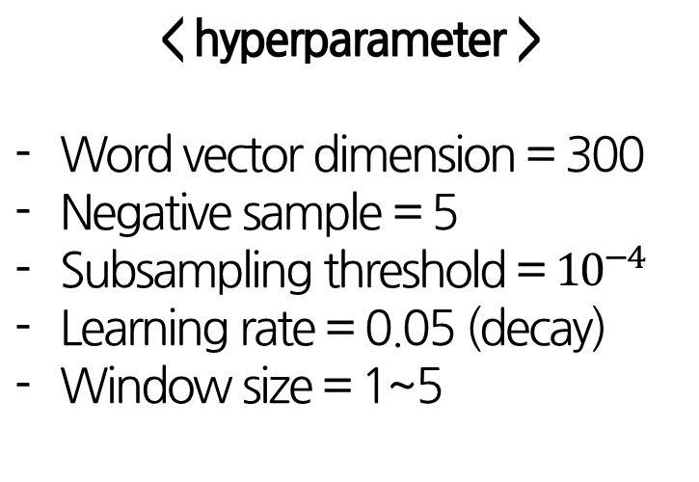
Experiment
< hyperparameter >
Word vector dimension = 300
Negative sample = 5
Subsampling threshold = ${10}^{−4}$
Learning rate = 0.05 (decay)
Window size = 1~5
[Subword model]
〮
〮
〮
〮
〮
〮
Notes:
experiment

Slide 15
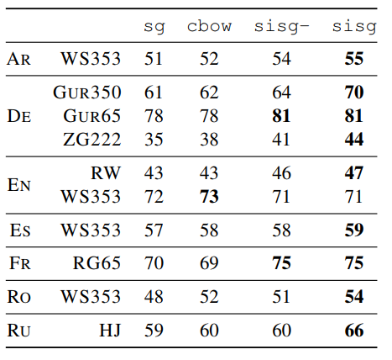
Experiment
[Human similarity judgement]
First,
The sisg model outperforms the baselines.
Second,
The effect of using character
n-grams is important
for morphology rich language.
Third,
The model is powerful
about Rare Words.
(단위 : %)
Notes:
싹다 마침표 / 대문자 / Second 수정

Slide 16
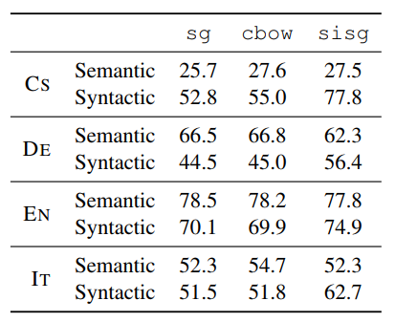
Experiment
[Word analogy tasks]
First,
The morphological information improves the syntactic tasks.
Second,
The improvement is more important for morphologically rich languages.
(단위 : %)
Notes:
말을 조금더 자세하게 다듬을 것

Slide 17
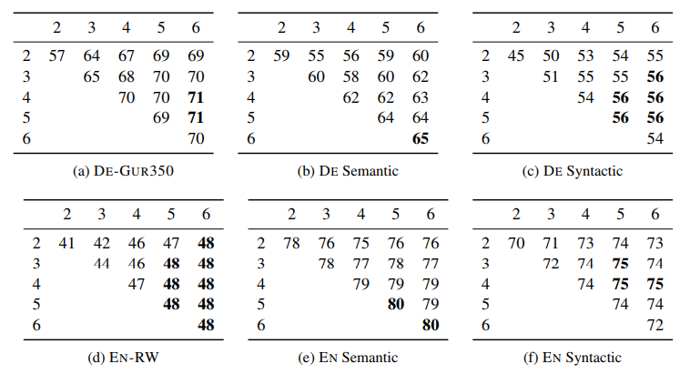
Experiment
[Effect of the size of n-grams]
(단위 : %)
First,
Using long n-grams
helps for semantic analogies.
Second,
Character
2-grams are
not informative.
Reasonable n-grams size is 3~6
Notes:
뭐에대한 퍼포먼스, ngram 정확한 해석 (어디에서 어디까지 그램이냐)

Slide 18
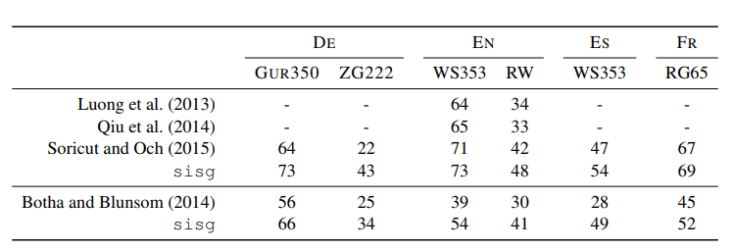
Experiment
[Comparison with morphological representations]
(단위 : %)
The approach performs well relative to techniques based on
subword information obtained from morphological segmentors.
Notes:
논문 다시 읽어볼것 -> 아마 임베딩이랑 다르게 접근했을 가능성ㅇ ㅣ있음

Slide 19
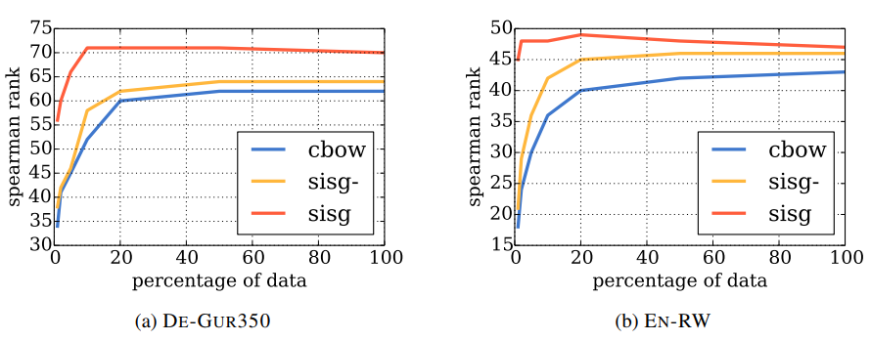
Experiment
[Effect of the size of the training data]
First,
The sisg model performs better than the baseline.
Second,
The approach provides good word vectors
even when using very small training datasets.
Notes:
특정 분야의 경우, 특정분야의 단어들로 모델링하는 것이 효율적 -> 하지만 데이터가 희귀하다 -> 해당 모델 적절
주어 동사 꼭 붙여서

Slide 20
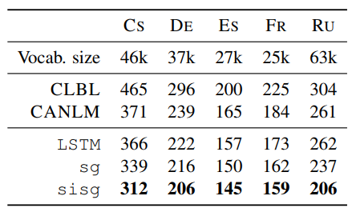
Experiment
[Language modeling]
First,
The pre-trained word representation improves
the test perplexity over the baseline LSTM.
Second,
Subword information outperforms the plain skipgram model.

Slide 21
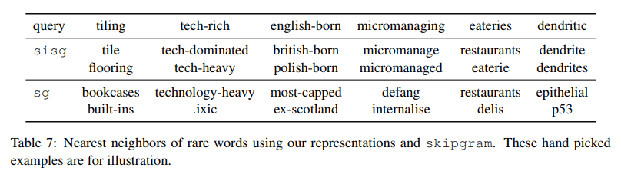
Experiment
[Nearest neighbors]
For complex, technical and infrequent words,
The sisg model are better than the baseline

Slide 22
Experiment
3-grams ~ 6-grams
3-gram : <wh, whe, her, ere, re>
4-gram : <whe, wher, here, ere>
5-gram : <wher, where, here>
6-gram : <where, where>
Special sequence
<where>

Slide 23
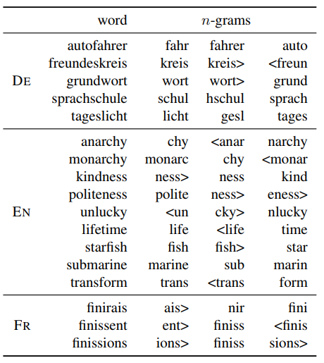
Experiment
[Character n-grams and morphemes]
Compound nouns : autofahrer
Affixes : kindness
unlucky
Inflection of verbs
With ending : :Finirais
Finissent
Finissions

Slide 24
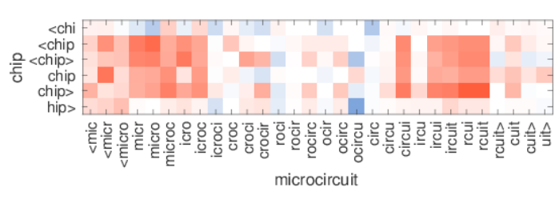
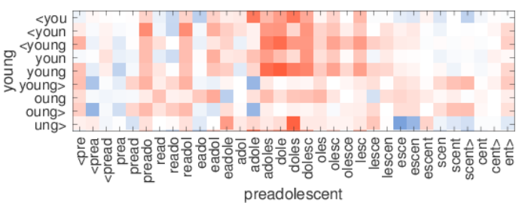
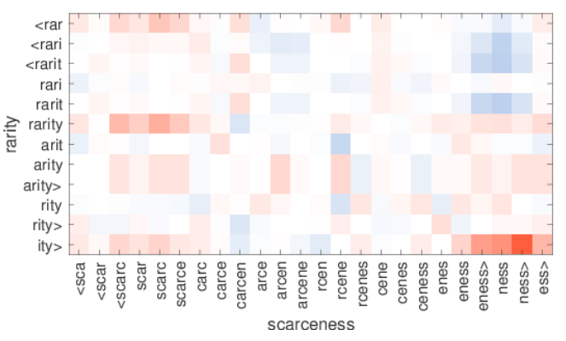
Experiment
[Word similarity]
Word1 | Word2
Microcircuit | Chip
Scarceness | Rarity
Preadolescent | Young

Slide 25
Conclusion
1. The model proved using morphological subword information
is effective for language modeling task.
The model outperforms word2vec skip-gram model
about OOV words problem.
Since no preprocessing or supervision are required,
subword model trains fast.
Notes:
마침표

Slide 26
Q&A
Q & A
Notes:
FastText 수정사항 embedding
논문두개합치기
해싱 어떻게든
실험은 분리, / 정확한설명덧붙어ㅕ서
Task 각각에 대해 간단하게

